Slide 1
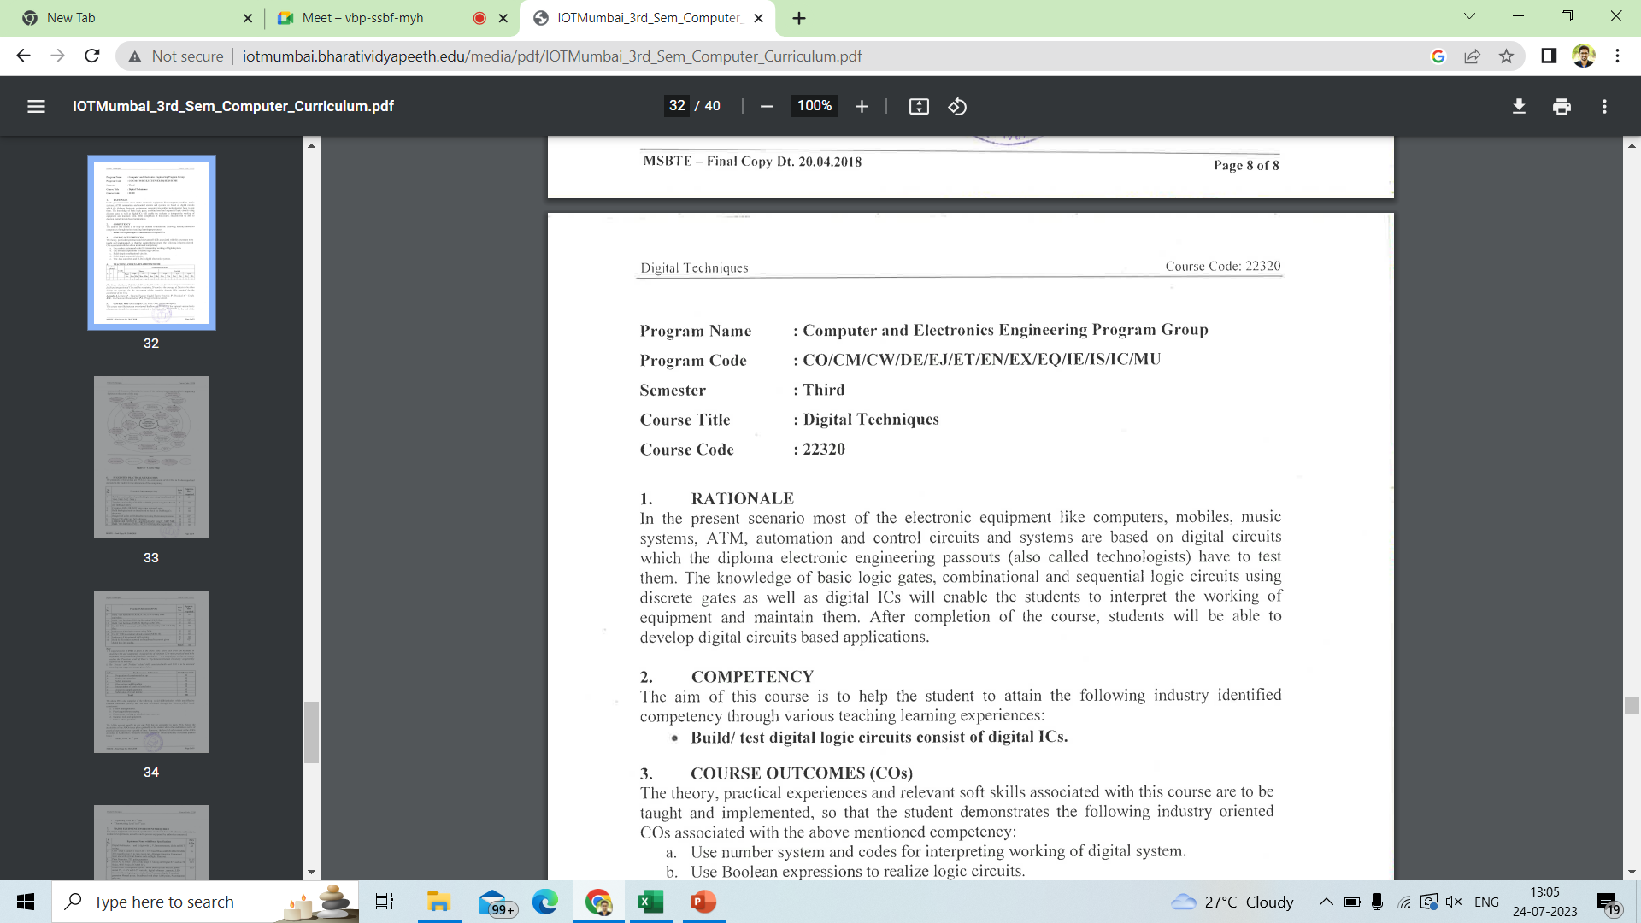
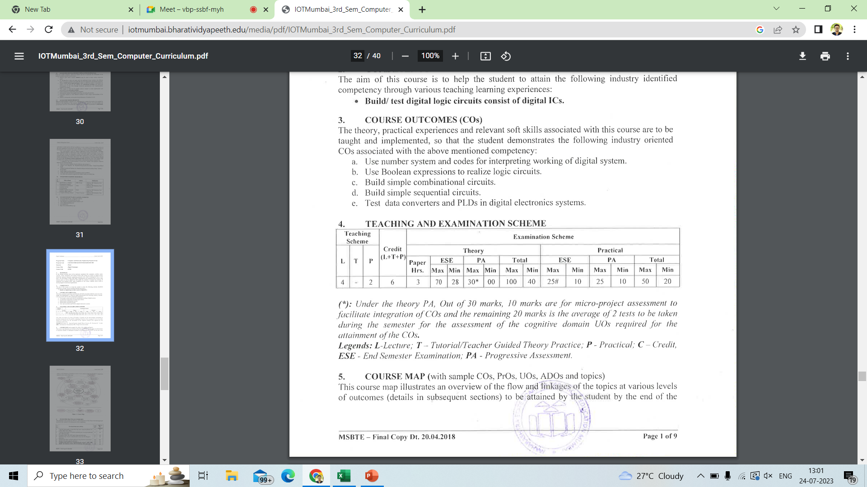

Slide 2
UNIT NO. | UNIT NAME
I | Number System and Codes[8 Marks]
II | Logic Gates and Logic Families[12 Marks]
III | Combinational logic[18 Marks]
IV | Sequential circuits[18 Marks]
V | Data Converters and PLDs[14 Marks]

Slide 3
System
Analog System : Deals with analog signals
Digital System : Deals with Digital signals
Analog Signal : continuously variable signal
Digital Signal : signals usually take only two levels

Slide 4
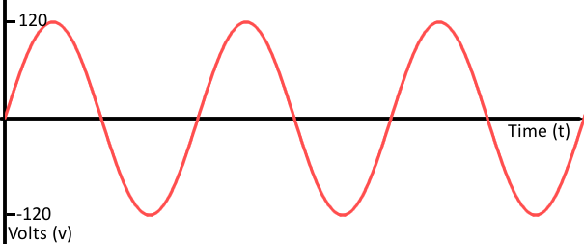
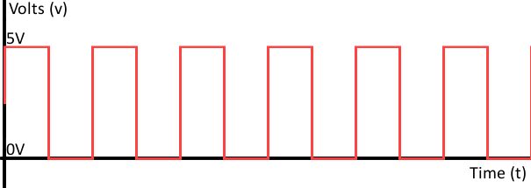
Analog signal
Digital signal

Slide 5
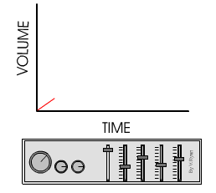

Slide 7
Digital Systems
Digital circuits are electronic circuits designed to operate with a fixed number of discrete voltage values.
Truth values, true and false, denoted T and F, respectively.
Boolean values, 1 and 0.
Voltage, the electrical potential between a point in the circuit and a common reference point, called “ground.” We call these values “high” and “low,” denoted H and L, respectively
‹#›
Notes:
‹#›

Slide 8
Digital Systems Application
Digital computers :
General purposes
Many scientific, industrial and commercial applications
Digital systems:
Telephone switching exchanges
Digital camera
Electronic calculators, PDA's
Digital TV

Slide 9
Digital Signal
For digital systems, the variable takes on discrete values.
Two level
Binary values are represented abstractly by:
Digits 0 and 1
Words (symbols) False (F) and True (T)
Words (symbols) Low (L) and High (H)
And words On and Off
Binary values are represented by
values or ranges of values of
physical quantities.
V(t)
Logic 1
undefine
Logic 0
t
Binary digital signal

Slide 10
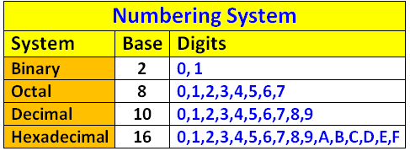
The Number system is the group of symbols used to represent the quantity.

Slide 11
Decimal Number System
The number of base or radix ten is called decimal numbers
Other number system is derived from this number.
It is generated with the combination of
0, 1, 2, 3, 4, 5, 6, 7, 8, 9.

Slide 12

Decimal Number System
Base (also called radix) = 10
10 digits { 0, 1, 2, 3, 4, 5, 6, 7, 8, 9 }
Digit Position
Integer & fraction
Digit Weight
Weight = (Base) ^{Position}
Magnitude
Sum of “Digit x Weight”
Formal Notation
2
1
0
-1
-2
5
1
2
7
4
100
10
1
0.1
0.01
500
10
2
0.7
0.04
d₂*B²+d₁*B¹+d₀*B⁰+d₋₁*B⁻¹+d₋₂*B⁻²
(512.74)₁₀

Slide 13
Binary Number System
Binary number is a number expressed in the binary numeral system or base-2
which represents numeric values using two different symbols: typically 0 (zero) and 1 (one)

Slide 14
Octal Number System
The octal number system, or oct for short, is the base-8 number system.
Uses the digits 0 to 7.
Octal numbers can be made from binary numbers by grouping consecutive binary digits into groups of three

Slide 15
Hexadecimal Number System
The hexadecimal number system, also known as just hex, is a number system made up of 16 symbols (base 16).
The standard number system is called decimal (base 10) and uses ten symbols: 0,1,2,3,4,5,6,7,8,9.
Hexadecimal uses the decimal numbers and includes six extra symbols
0,1,2,3,4,5,6,7,8,9,A,B,C,D,E and F

Slide 16
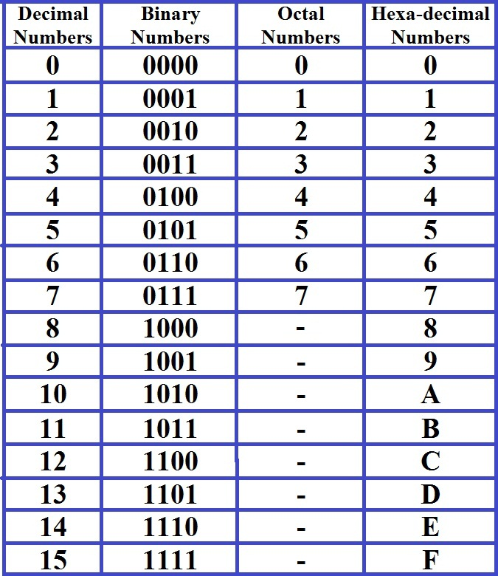

Slide 17
Decimal to binary conversion
An easy method of converting decimal to binary number equivalents is to write down the decimal number and to continually divide-by-2 (two) to give a result and a remainder of either a “1” or a “0” until the final result equals zero.
Ex.
1. Convert (11)₁₀ into binary
2. Convert (29)₁₀ into binary
3. Convert (30)₁₀ into binary
4. Convert (50)₁₀ into binary

Slide 18
Fractional decimal to binary conversion
Write down the fractional number and to continually multiply-by-2 (two) till the fractional part of product is zero
Ex.
1. Convert (0.652)₁₀ into binary
2. Convert (0.6875)₁₀ into binary
3. Convert (3.4375)₁₀ into binary
4. Convert (11.6875)₁₀ into binary

Slide 19
Binary to Decimal conversion
Any binary number can be converted to its equivalent decimal number by adding together the weights of various positions in the binary number which contains 1.
Ex.
1. Convert (1011)₂ into decimal
2. Convert (110110)₂ into decimal
3. Convert (0111.11)₂into decimal
4. Convert (1100.010)₂ into decimal

Slide 20
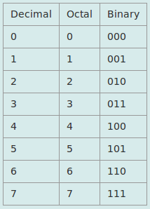
Octal to Binary conversion
3-bits binary numbers are written for each octal digit.
Ex.
1. Convert (652)₈ into binary
2. Convert (5432.76)₈ into binary
3. Convert (437.21)₈ into binary

Slide 21
Binary to Octal conversion
- Make 3-bits grouping from last bit.
- Convert each group into decimal numbers.
Ex.
1. Convert (1011010011)₂ into octal number.
2. Convert (1101010)₂ into octal number.
3. Convert (1101.11011)₂ into octal number.
4. Convert (101010111)₂ into octal number.

Slide 22
Octal to Decimal conversion
An octal number can be converted to its decimal equivalent by multiplying each octal digit by its equivalent position weight.
Ex.
1. Convert (250)₈ into decimal
2. Convert (150)₈ into decimal
3. Convert (37.7)₈ into decimal
4. Convert (52.3)₈ into decimal

Slide 23
Decimal to Octal conversion
To convert a decimal number to octal, decimal number is divided by 8 till the quotient becomes zero
Ex.
1. Convert (6458)₁₀ to octal
2. Convert (255)₁₀ to octal
3. Convert (211)₁₀ to octal

Slide 24
Fractional decimal to octal conversion
Write down the fractional number and continually multiply-by-8 (eight) till the fractional part of product is zero
Ex.
1. Convert (0.225)₁₀ into octal
2. Convert (0.615)₁₀ into octal
3. Convert (177.25)₁₀ into octal

Slide 25
Hexadecimal to Decimal conversion
An hexadecimal number can be converted to its decimal equivalent by multiplying each hexadecimal digit by its equivalent position weight.
Ex.
1. Convert (268)₁₆ into decimal
2. Convert (456E)₁₆ into decimal
3. Convert (11A.62)₁₆ into decimal

Slide 26
Decimal to Hexadecimal conversion
To convert a decimal number to hexadecimal, decimal number is divided by 16 till the quotient becomes zero
Ex.
1. Convert (200)₁₀ to hexadecimal
2. Convert (792)₁₀ to hexadecimal
3. Convert (300)₁₀ to hexadecimal

Slide 27
Fractional decimal to hexadecimal conversion
Write down the fractional number and to continually multiply-by-16 till the fractional part of product is zero
Ex.
1. Convert (0.652)₁₀ into Hexadecimal
2. Convert (2001.43)₁₀ into Hexadecimal

Slide 28
Hexadecimal to Binary conversion
4-bits binary numbers are written for each hexadecimal digit.
Ex.
1. Convert (D283)₁₆ into binary
2. Convert (57EB.AD)₁₆ into binary

Slide 29
Binary to Hexadecimal conversion
- Make 4-bits grouping from last bit.
- Convert each group into hexadecimal numbers.
Ex.
1. Convert (1011010011)₂ into hexadecimal number.
2. Convert (1101010)₂ into hexadecimal number.
3. Convert (1101.11011)₂ into hexadecimal number.
4. Convert (101010111)₂ into hexadecimal number.

Slide 30
Octal to Hexadecimal conversion
- Represent the given octal number using equivalent 3 bit binary number.
- Make 4-bits grouping from last bit.
- Convert each group into hexadecimal numbers.
Ex.
1. Convert (537)₈ into hexadecimal number.
2. Convert (146)₈ into hexadecimal number.

Slide 31
Hexadecimal to Octal conversion
- Represent the given hexadecimal number using equivalent 4 bit binary number.
- Make 3-bits grouping from last bit.
- Convert each group into octal numbers.
Ex.
1. Convert (3DB)₁₆ into octal number.
2. Convert (5CB.12E)₁₆ into octal number.

Slide 32
Floating-point number
A real number (that is, a number that can contain a fractional part). The following are floating-point numbers:
Ex.
3.0
-111.5

Slide 33
Codes
Weighted code
Non-Weighted
code
Alphanumeric
code
Error detecting &
correcting code
1. BCD Code
2. Binary Code
1. ASCII Code
2. EBCDIC Code
3. Hollerith Code
1. Excess – 3 Code
2. Gray Code
1. Hamming Code
2. Parity code

Slide 34
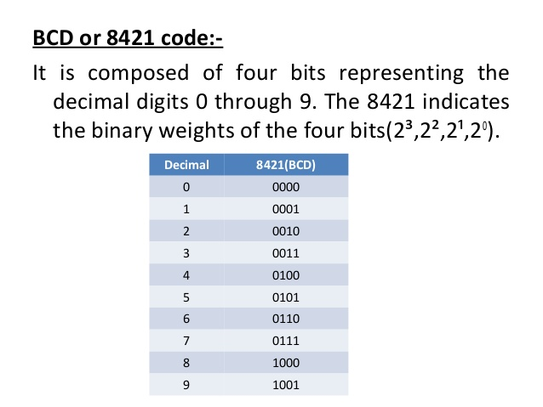

Slide 35
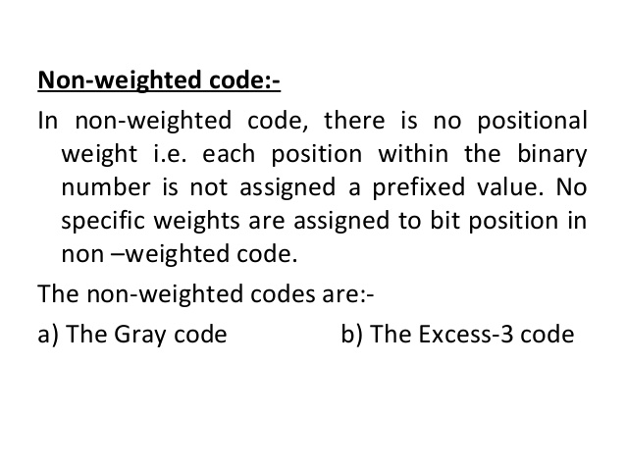

Slide 36
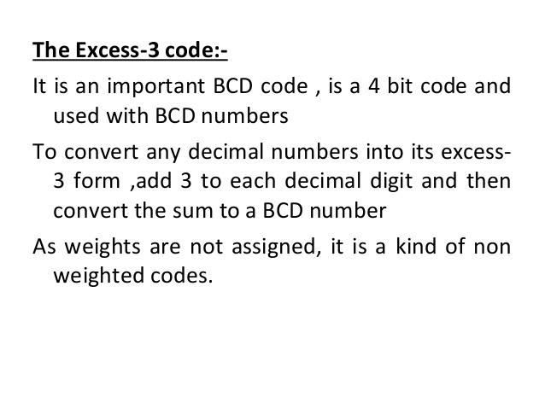

Slide 37
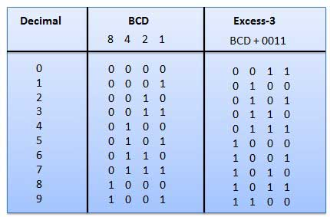

Slide 38
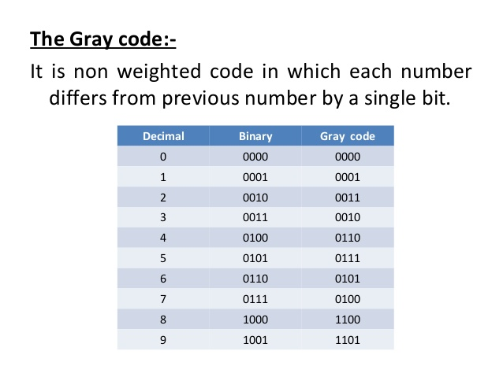

Slide 39
ASCII Code
ASCII stands for the "American Standard Code for Information Interchange".
It was designed in the early 60's, as a standard character set for computers and electronic devices.
ASCII is a 7-bit character set containing 128 characters.
It contains the numbers from 0-9, the upper and lower case English letters from A to Z, and some special characters.
The character sets used in modern computers, in HTML, and on the Internet, are all based on ASCII.

Slide 40
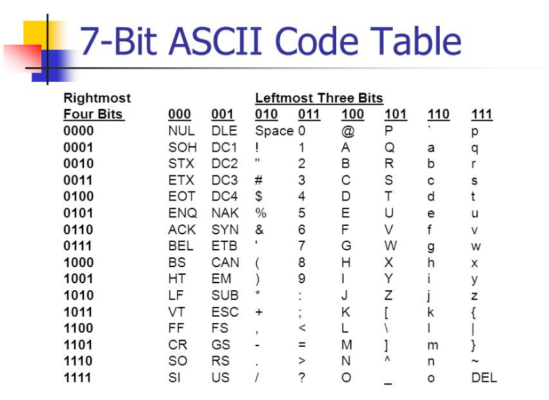

Slide 41
Binary Arithmetics

Slide 42
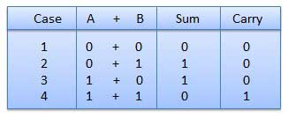
Binary Addition
There are four rules of binary addition.

Slide 43
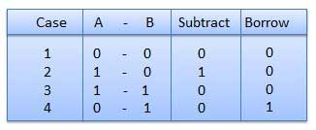
Binary Subtraction
Subtraction and Borrow, these two words will be used very frequently for the binary subtraction. There are four rules of binary subtraction.
eg.
1110
- 1011
------------
0011

Slide 44
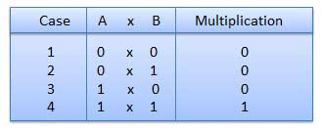
Binary Multiplication
Binary multiplication is similar to decimal multiplication. It is simpler than decimal multiplication because only 0s and 1s are involved. There are four rules of binary multiplication.
1 0 1 1 (A)
× 1 0 1 0 (B)
---------
0 0 0 0 ← Corresponds to the rightmost 'zero' in B
+ 1 0 1 1 ← Corresponds to the next 'one' in B
+ 0 0 0 0
+1 0 1 1
---------------
= 1 1 0 1 1 1 0

Slide 45
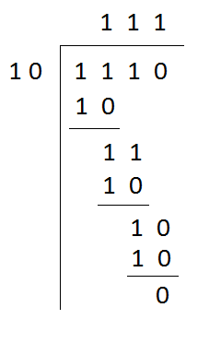
Binary Division
Binary division is similar to decimal division. It is called as the long division procedure.
1 0 1
___________
1 0 1 ) 1 1 0 1 1
− 1 0 1
-----
1 1 1
− 1 0 1
-----
1 0

Slide 46
Binary subtraction using 1's complement
1. Find 1's complement of the subtrahend B
2. Add 1's complement of B to A
3. If final carry is 1, then add it to the result(Result is positive)
4. If carry produced in step 2 is 0, then the answer is 1's complement of the result and negative.
Ex.
1. To subtract 10101 from 11101
2. To subtract 1100 from 1000
3. Perform (10)₁₀ - (05)₁₀

Slide 47
Binary subtraction using 2's complement
(i) At first, 2’s complement of the subtrahend is found.
(ii) Then it is added to the minuend.
(iii) If the final carry over of the sum is 1, it is dropped and the result is positive.
(iv) If there is no carry over, the two’s complement of the sum will be the result and it is negative.
Ex.
1. Perform (12)₁₀ - (8)₁₀
2. To subtract 1011 from 1001

Slide 48
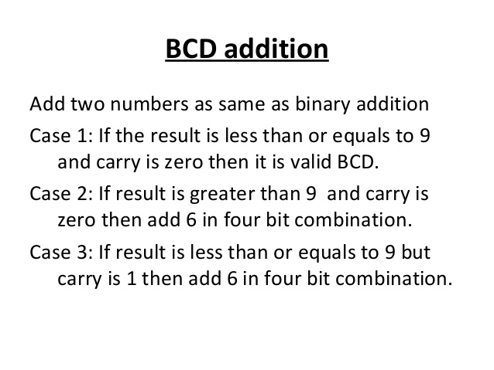

Slide 49
1. Add (3)₁₀ + (4)₁₀ in BCD.
2. Add (709)₁₀ + (698)₁₀ in BCD.

